Slide 1
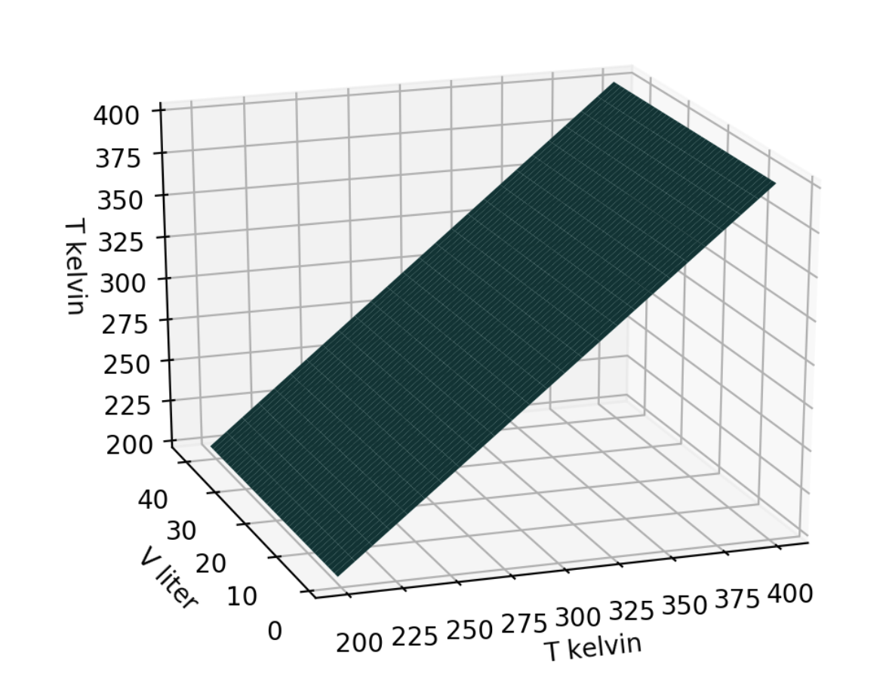
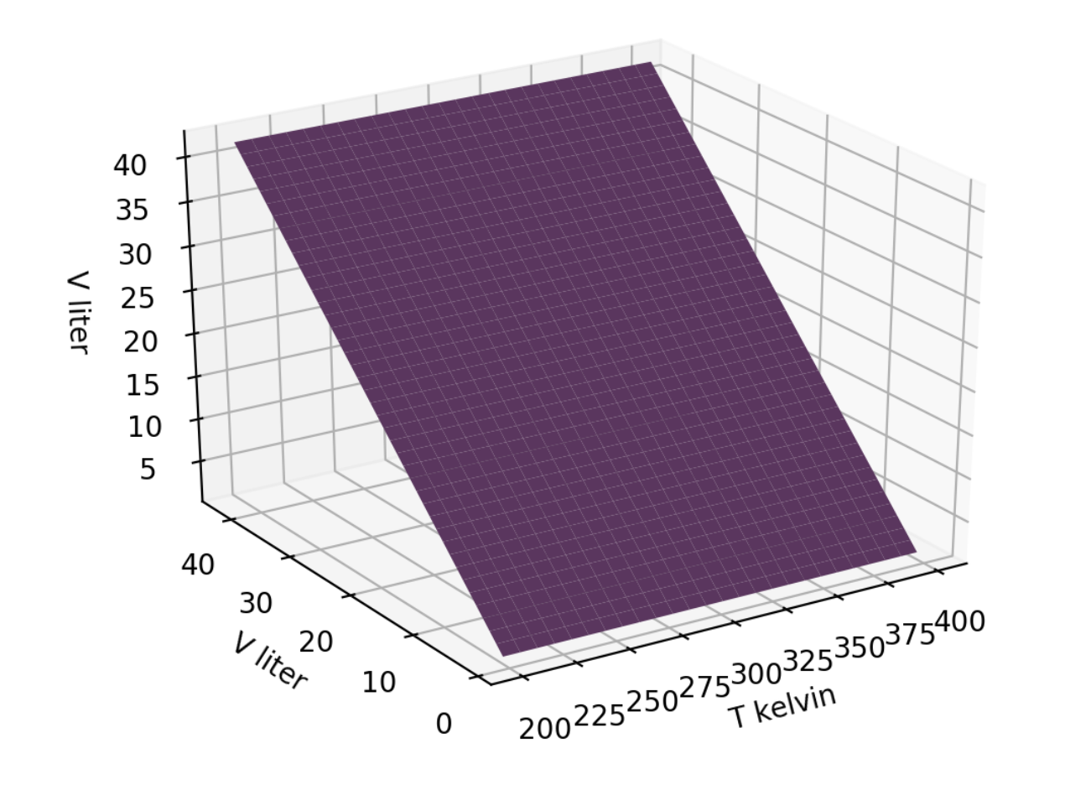


Recap: Visualizing state space
$$T\left(T,V\right)$$
$$V\left(T,V\right)$$
42 volumes
42 volumes
51 temperatures
51 temperatures

Slide 2
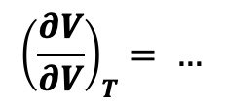
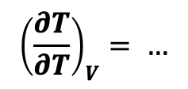
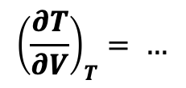
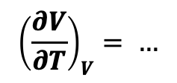
Recap: The “no-brainer” rules of partial derivatives
$$T\left(T,V\right)$$
$$V\left(T,V\right)$$
$${\left(\frac{∂T}{∂V}\right)}_{T}= …$$
$${\left(\frac{∂V}{∂V}\right)}_{T}= …$$
$${\left(\frac{∂T}{∂T}\right)}_{V}= …$$
$${\left(\frac{∂V}{∂T}\right)}_{V}= …$$

Slide 3
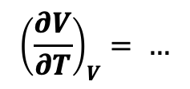
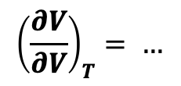
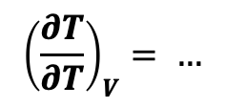


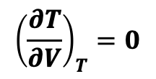
Recap: The “no-brainer” rules of partial derivatives
$$T\left(T,V\right)$$
$$V\left(T,V\right)$$
$${\left(\frac{∂T}{∂V}\right)}_{T}=0$$
$${\left(\frac{∂V}{∂V}\right)}_{T}= …$$
$${\left(\frac{∂T}{∂T}\right)}_{V}= …$$
$${\left(\frac{∂V}{∂T}\right)}_{V}= …$$

Slide 4
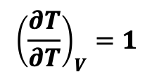
Recap: The “no-brainer” rules of partial derivatives
$$T\left(T,V\right)$$
$$V\left(T,V\right)$$
$${\left(\frac{∂T}{∂V}\right)}_{T}=0$$
$${\left(\frac{∂V}{∂V}\right)}_{T}= …$$
$${\left(\frac{∂T}{∂T}\right)}_{V}=1$$
$${\left(\frac{∂V}{∂T}\right)}_{V}= …$$

Slide 5
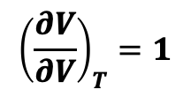
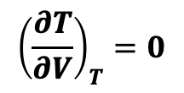
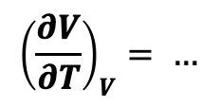
Recap: The “no-brainer” rules of partial derivatives
$$T\left(T,V\right)$$
$$V\left(T,V\right)$$
$${\left(\frac{∂T}{∂V}\right)}_{T}=0$$
$${\left(\frac{∂V}{∂V}\right)}_{T}=1$$
$${\left(\frac{∂T}{∂T}\right)}_{V}=1$$
$${\left(\frac{∂V}{∂T}\right)}_{V}= …$$

Slide 6
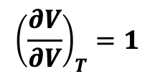
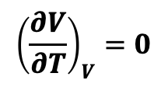
Recap: The “no-brainer” rules of partial derivatives
$$T\left(T,V\right)$$
$$V\left(T,V\right)$$
$${\left(\frac{∂T}{∂V}\right)}_{T}=0$$
$${\left(\frac{∂V}{∂V}\right)}_{T}=1$$
$${\left(\frac{∂T}{∂T}\right)}_{V}=1$$
$${\left(\frac{∂V}{∂T}\right)}_{V}=0$$

Slide 7
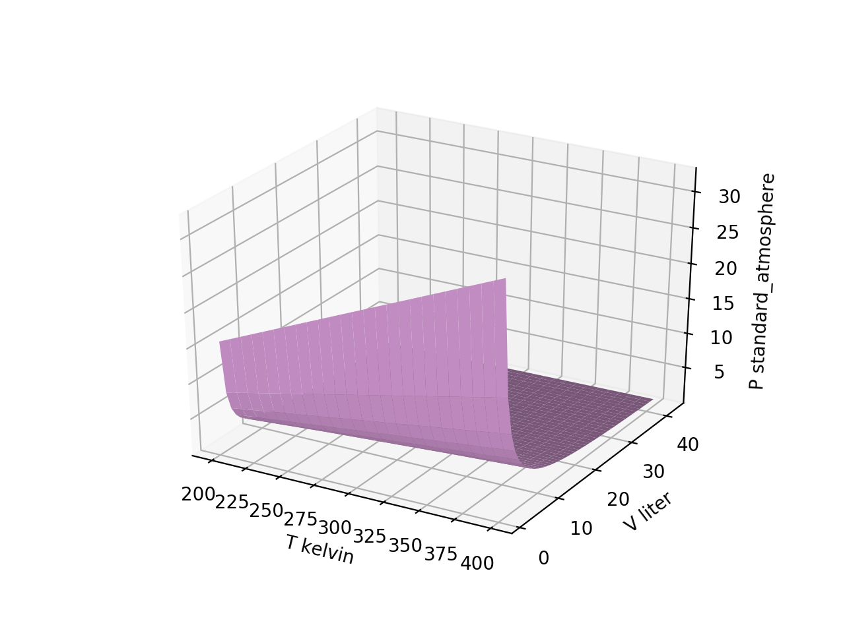
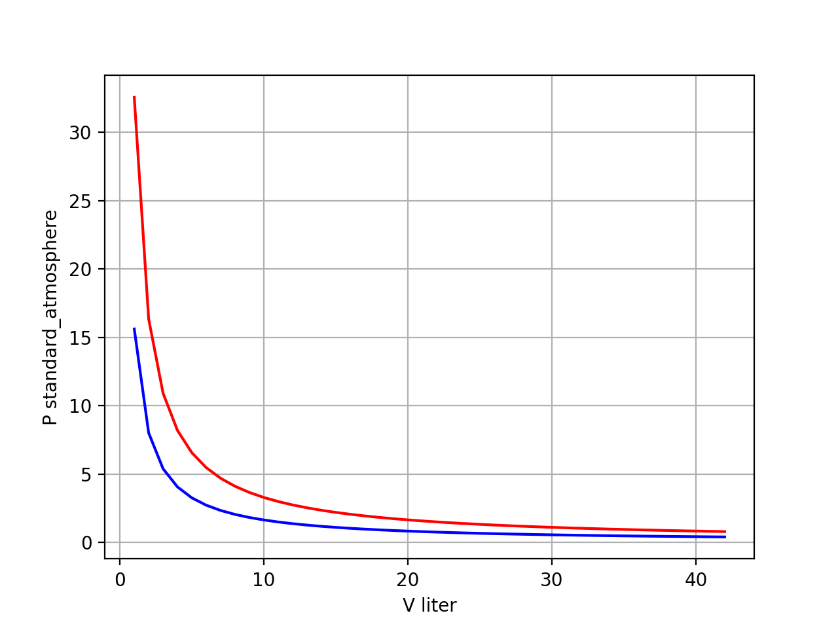
Recap: Slices of $P(T,V)$
isotherms
42 volumes
42 volumes

Slide 8
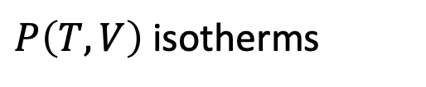

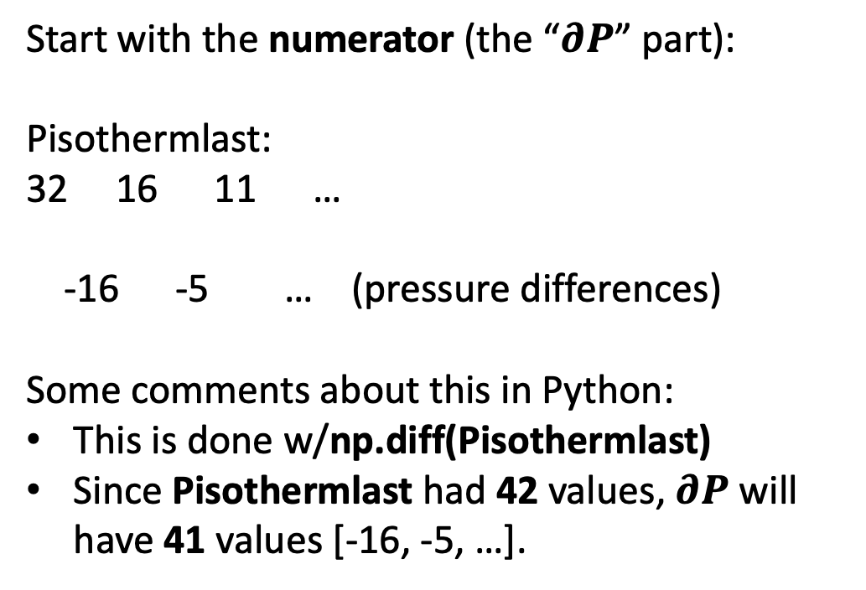
How are numerical derivatives calculated?
Say we want ${\left(\frac{∂P}{∂V}\right)}_{T}$
Start with the numerator (the “$∂P$” part):
Pisothermlast:
32 16 11 …
-16 -5 … (pressure differences)
Some comments about this in Python:
This is done w/np.diff(Pisothermlast)
Since Pisothermlast had 42 values, $∂P$ will have 41 values [-16, -5, …].
32
$P\left(T,V\right)$isotherms
16
11

Slide 9
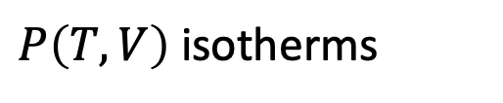
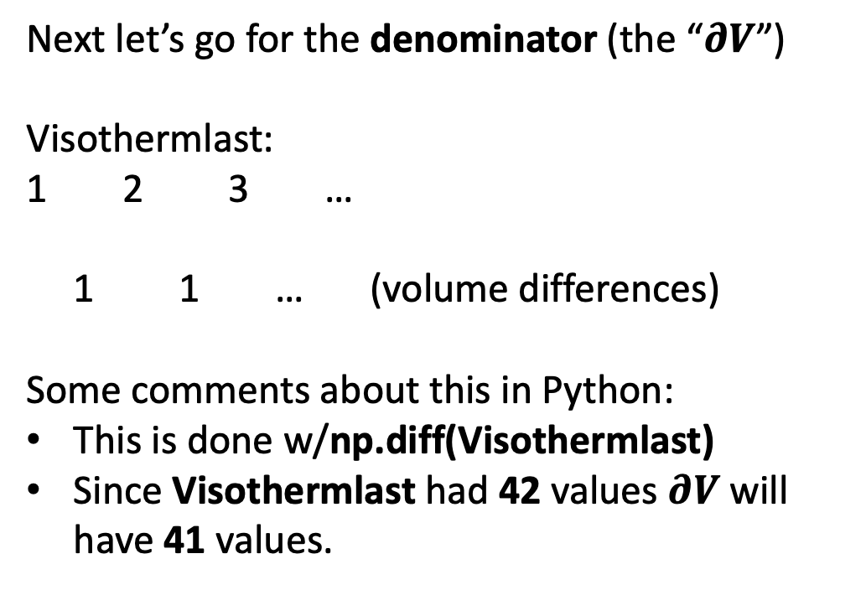
How are numerical derivatives calculated?
Say we want ${\left(\frac{∂P}{∂V}\right)}_{T}$
Next let’s go for the denominator (the “$∂V$”)
Visothermlast:
1 2 3 …
1 1 … (volume differences)
Some comments about this in Python:
This is done w/np.diff(Visothermlast)
Since Visothermlast had 42 values $∂V$ will have 41 values.
32
$P\left(T,V\right)$isotherms
16
11
1,2,3,…

Slide 10
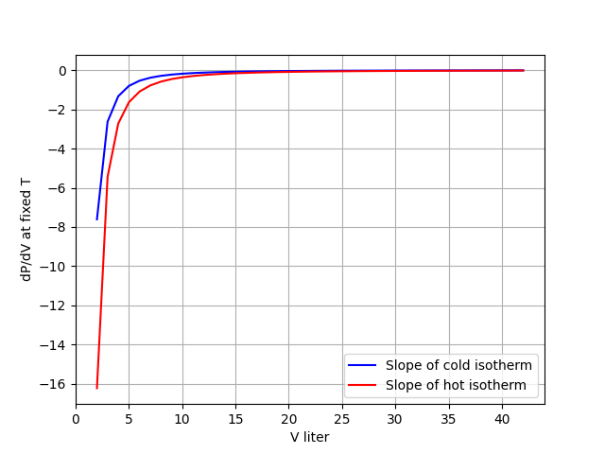
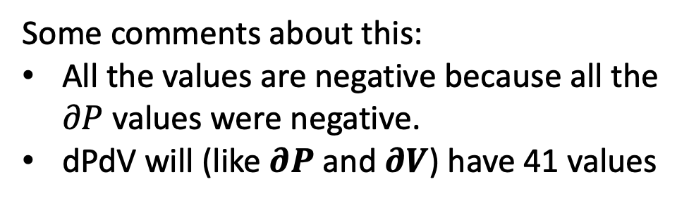

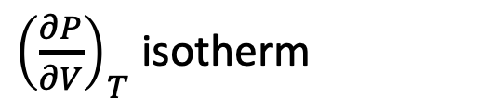
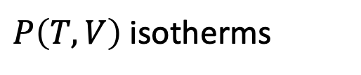
How are numerical derivatives calculated?
Getting ${\left(\frac{∂P}{∂V}\right)}_{T}$ is easy now:
$P\left(T,V\right)$isotherms
dPdV =
np.diff(Pisothermlast)/np.diff(Visothermlast)
Some comments about this:
All the values are negative because all the $∂P$ values were negative.
dPdV will (like $∂P$ and $∂V$) have 41 values
${\left(\frac{∂P}{∂V}\right)}_{T}$ isotherm

Slide 11
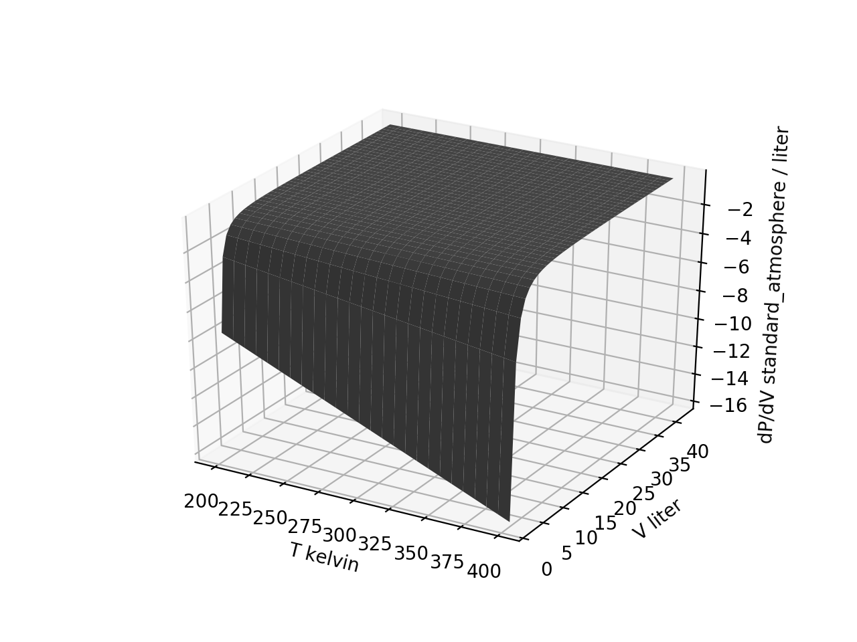
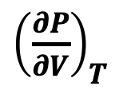

Next: numerical derivative (with respect to volume) of the entire $P\left(T,V\right)$ surface
${\left(\frac{∂P}{∂V}\right)}_{T}$
$$P\left(T,V\right)$$

Slide 12
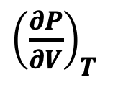

Next: numerical derivative (with respect to volume) of the entire $P\left(T,V\right)$ surface
${\left(\frac{∂P}{∂V}\right)}_{T}$
$$P\left(T,V\right)$$

Slide 13
Next: numerical derivative (with respect to volume) of the entire $P\left(T,V\right)$ surface
${\left(\frac{∂P}{∂V}\right)}_{T}$
$$P\left(T,V\right)$$
42 volumes
41 volumes
51 temperatures
51 temperatures

Slide 14
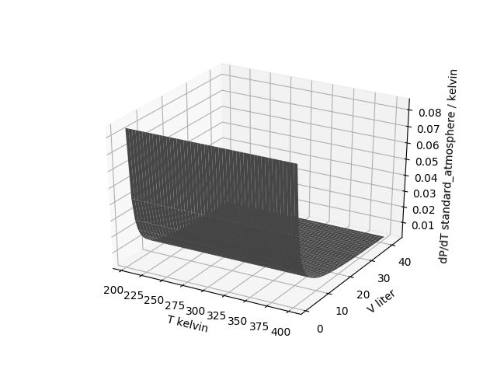
Next: numerical derivative (with respect to temperature) of the entire $P\left(T,V\right)$ surface
42 volumes
42 volumes
51 temperatures
50 temperatures

Slide 15
Next: numerical derivative (with respect to temperature) of the entire $P\left(T,V\right)$ surface
42 volumes
50 temperatures

Slide 16
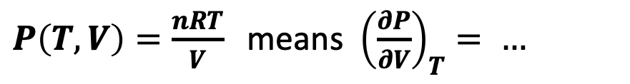
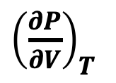

${\left(\frac{∂P}{∂V}\right)}_{T}$ of the entire $P\left(T,V\right)$ surface when you have an analytical representation of $P\left(T,V\right)$
$P\left(T,V\right)=\frac{nRT}{V}$ means ${\left(\frac{∂P}{∂V}\right)}_{T}= …$
${\left(\frac{∂P}{∂V}\right)}_{T}$
$$P\left(T,V\right)$$

Slide 17
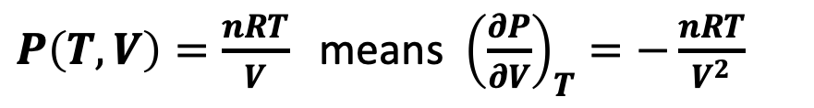
${\left(\frac{∂P}{∂V}\right)}_{T}$ of the entire $P\left(T,V\right)$ surface when you have an analytical representation of $P\left(T,V\right)$
$P\left(T,V\right)=\frac{nRT}{V}$ means ${\left(\frac{∂P}{∂V}\right)}_{T}=−\frac{nRT}{V^{2}}$
You could plot this too (for comparison to the numerical result)
${\left(\frac{∂P}{∂V}\right)}_{T}$
$$P\left(T,V\right)$$

Slide 18
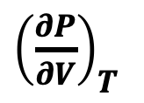

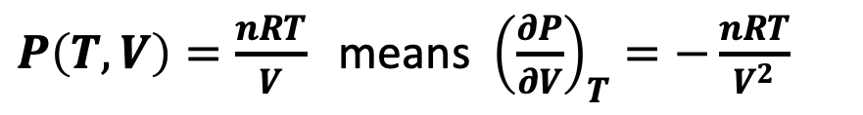
${\left(\frac{∂P}{∂V}\right)}_{T}$ of the entire $P\left(T,V\right)$ surface when you have an analytical representation of $P\left(T,V\right)$
$P\left(T,V\right)=\frac{nRT}{V}$ means ${\left(\frac{∂P}{∂V}\right)}_{T}=−\frac{nRT}{V^{2}}$
You could plot this too (for comparison to the numerical result)
Question: Why is Nesh having me learn both an analytical method (like this) to a numerical one (what we got using PL.df_dx)?
${\left(\frac{∂P}{∂V}\right)}_{T}$
$$P\left(T,V\right)$$

Slide 19
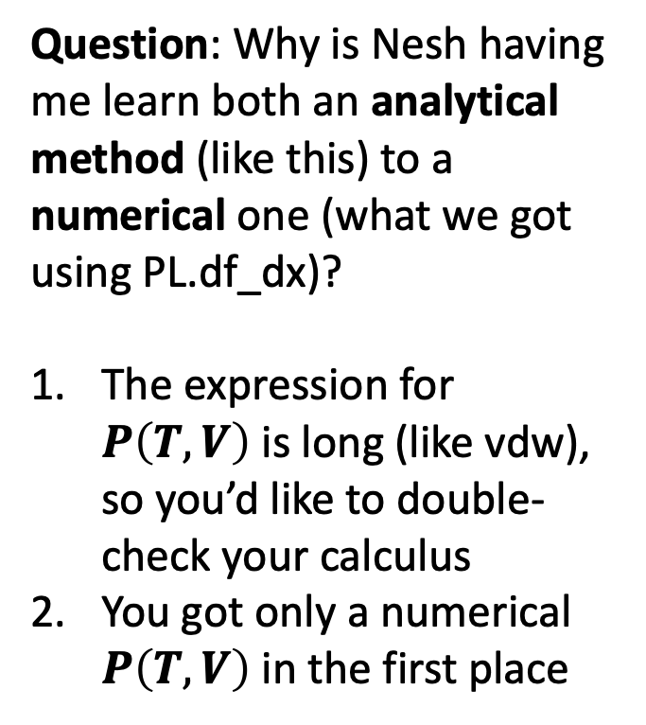
${\left(\frac{∂P}{∂V}\right)}_{T}$ of the entire $P\left(T,V\right)$ surface when you have an analytical representation of $P\left(T,V\right)$
$P\left(T,V\right)=\frac{nRT}{V}$ means ${\left(\frac{∂P}{∂V}\right)}_{T}=−\frac{nRT}{V^{2}}$
You could plot this too (for comparison to the numerical result)
Question: Why is Nesh having me learn both an analytical method (like this) to a numerical one (what we got using PL.df_dx)?
The expression for $P\left(T,V\right)$ is long (like vdw), so you’d like to double-check your calculus
You got only a numerical $P\left(T,V\right)$ in the first place
${\left(\frac{∂P}{∂V}\right)}_{T}$
$$P\left(T,V\right)$$

Slide 20
